Slide 1
Security Issue Mitigation
Recommendations for Blue Ink
Martin Ponce, ID 10371381
CSI1101 Computer Security
ES Off-Campus
Tutor: Patryk Szewczyk

Slide 2
Introduction

Slide 3
During this presentation… We will assume that:
User “green” is a standard employee
A back-up strategy is in place and out of scope
Blue Ink is a large enterprise
Computers connected to LAN and WAN
A firewall in place and protects network

Slide 4
In the previous report… We found security issues with:
The operating system
Third party applications
User practices

Slide 5
This presentation will… Recommend solutions to each of those issues and:
Outline advantages/disadvantages where possible
Introduce alternatives where possible
Briefly discuss process where possible
Starting with…

Slide 6
The operating system

Slide 7
Some facts about Windows Vista Business
separator
It’s getting old
Superseded by two versions of Windows
Almost three, with pending release of Windows 10
Will eventually become obsolete
Extended support ends on 11 April 2017 (Microsoft, 2015)
Third party applications used by Blue Ink may also eventually end support for Vista

Slide 8
What does this mean?
separator
Microsoft will no longer provide security updates for Vista after 11 April 2017
If or when vendors of third party applications decide to stop supporting Vista
That particular application may no longer receive security updates as well

Slide 9
What are security updates anyway?
separator
When a security vulnerability in a program has been found or disclosed, the developer may release an update for the program to resolve the known vulnerability in order to stop it from being exploited by attackers.

Slide 10
So how can we fix it? Upgrade!
separator
Upgrade to a modern version of Microsoft Windows
ie. Windows 8.1, Microsoft’s latest version of Windows

Slide 11
Advantages to upgrading…
separator
Computer/s will no longer be susceptible to vulnerabilities associated with Windows Vista
Microsoft’s support will be extended (Microsoft, 2014)
ie. Microsoft Windows 8.1 support ends 9 January 2018
Extended support ends 10 January 2023
Software included with operating system such as Internet Explorer or Windows Defender will also be upgraded
ie. Windows 8.1 ships with Internet Explorer 11 (Microsoft, n.d.)

Slide 12
Disadvantages to upgrading…
separator
New license for each copy of OS must be purchased
Current hardware may need upgraded to run new OS
Deployment of new OS may require down time
Users may depend on software which may not be compatible with new OS
Staff may require training in use of new OS
User interface may have evolved since Vista
Computer/s will then become susceptible to unresolved vulnerabilities in new OS

Slide 13
What’s the alternative option? Update!
separator
Service packs and security updates must be installed
Blue Ink’s computers do not have any installed
At the moment, 524 known vulnerabilities exist for all versions of Windows Vista (Ozkan, 2015)
From SP0 through to SP2
Right now, Blue Ink’s computers are susceptible to all of them
Including…

Slide 14
CVE-2008-0951 Auto-run vulnerability (SecurityFocus, 2008)
separator
Allows an attacker to include malicious code on removable media
ie. CD-ROM or USB drive
The malicious code will be executed once the removable media is inserted into the computer

Slide 15
Without any updates…
Blue Ink’s computers are susceptible to all 524 known vulnerabilities.
Lack of updates have also kept included software such as Internet Explorer severely outdated.
separator
Internet Explorer version | No. of vulnerabilities
IE 7 | 206
IE 8 | 249
IE 9 * | 292
* IE 9 is latest compatible version with Vista.
Excerpt of IE vulnerabilities list (Ozkan, n.d.).

Slide 16
CVE-2013-3918 Active-X Control vulnerability (Microsoft, 2013; Ozkan, 2013)
separator
A vulnerability in Internet Explorer 7
Allows an attacker to remotely execute code on a victim’s computer through a malicious website
Was exploited in a “watering hole attack” which silently propagated malware on website viewer’s computers (Chen & Casalden, 2013; Moran, 2013; Wilson, 2013)
Blue Ink’s computers are currently not safe from it

Slide 17
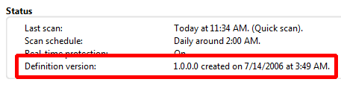
Windows Defender
separator
Also affected by lack of updates
Severely obsolete virus/malware signatures list
No updates since version 1.0.0.0 on 14 July 2006
In order for anti-malware/virus program to be effective, it must have its signatures list regularly updated
So that it can protect the computer from current known threats (Goodrich & Tamassia, 2011)
Blue Ink’s computers failed to detect www.eicar.org pseudo-viruses

Slide 18
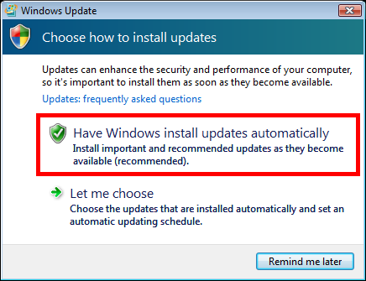
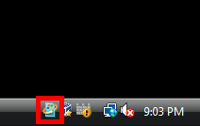
So how can we fix it?
separator
Enable “Automatic Updates” in Vista
Click the highlighted icon in the Notification Area on the right side of the task bar
Then select “Have Windows install updates automatically”

Slide 19
Advantages to updating…
separator
No cost involved when installing service packs or security updates
Most known vulnerabilities will be secure
ie. Auto-run and Active-X Control vulnerabilities will be mitigated
Internet Explorer will be updated to version 9
Windows Defender will be updated with latest signatures
Staff will not require training in use
No changes to user interface

Slide 20
Disadvantages to updating…
separator
Still vulnerable to latest threats until Microsoft patch them
Downloading all updates will cost bandwidth
May take time to download all updates
Internet Explorer 9 still susceptible to various vulnerabilities
Security updates will no longer be received after 11 April 2017
Any vulnerabilities after the last security update will not be resolved

Slide 21
References
Microsoft. (2015). Microsoft Support Lifecycle. Microsoft. Retrieved February 27, 2015, from http://support.microsoft.com/lifecycle/search/default.aspx?alpha=Vista

